Slide 1
NEO4J CYPHER TUTORIAL WITH PYTHON
PATTERENS
Tutorial 31

Slide 2
PATTERN
Patterns and pattern-matching are at the very heart of Cypher, so being effective with Cypher requires a good understanding of patterns.
Using patterns, you describe the shape of the data you’re looking for. For example, in the MATCH clause you describe the shape with a pattern, and Cypher will figure out how to get that data for you.
The pattern describes the data using a form that is very similar to how one typically draws the shape of property graph data on a whiteboard: usually as circles (representing nodes) and arrows between them to represent relationships.

Slide 3
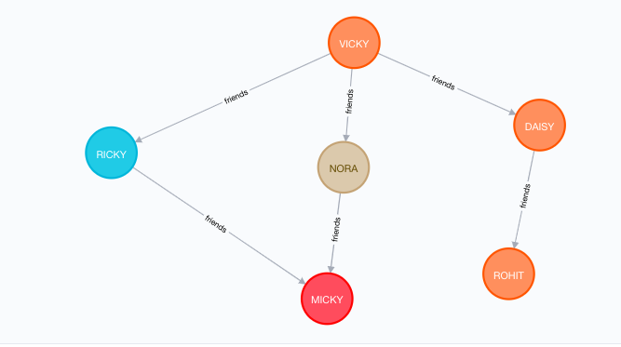
PATTERN

Slide 4
EXAMPLES OF PATTERN WITH RELATIONSHIP
(A)-[]->(B)
match (A)-[]->(B)
return A,B
Dynamic or multiple patterns
(A)-[*1..3]->(B)
match (A{NAME:"VICKY"})-[*2]->(B{NAME:"RICKY"})
return A,B

